Slide 1
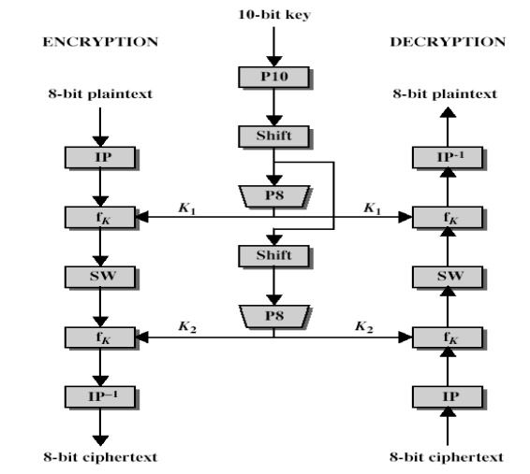
S-DES
Symmetric key encryption
Based on Feistel Design structure
There are 2 rounds of function generation.
Permutation is always going to happen before substitution stage.
Plain text must be of 8 bitS block and Initial key is of 10 bits block.
There must be subkeys generation from intial key to generate round function at round 1 and 2.

Slide 2
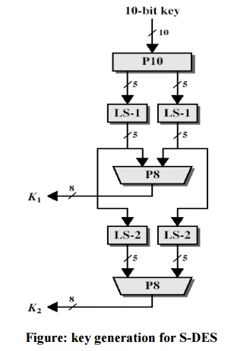


KEY GENERATION FOR ENCRYPTION
STEP 1- Take key of 10 bits and apply permutation 10 (P10)
STEP 2- Divide the permuted output bits in equal length left and right halves
STEP 3- Left shift the left And right halves of permuted bits by one.(depends upon the round no. As here it is 1).
STEP 4- combine the generated left and right halves and then apply permutation 8(P8).This permuted 8 bit block is the subkey(K1) generated at round 1.

Slide 3
KEY GENERATION FOR ENCRYPTION
STEP 6- Now again devide the permuted 8 bit block into two halves left and right.
STEP 7- Apply left shift by 2 in both the blocks.
STEP 8- After applying shifting for round 2 combine both the blocks and apply permutation 8 P8,this is the Subkey for round 2(K2).

Slide 4


FINAL ENCRYPTION
STEP 1- TAKE THE 8 BITS BLOCK OF PLAIN TEXT AND APPLY INITIAL PERMUTATION 8 (IP 8).
STEP 2- Split the block into left and right halves.Take the Right half of IP8 and apply expand bit on right half of IP 8.
STEP 3- X-OR the 8 bits block of subkey 1(K1) & Expanded bits and generate the output bits.
STEP 4- SPLIT THE OUTPUT BITS INTO LEFT AND RIGHT BLOCKS AND PUT THE VALUE ON S-BOX(SUBSTITUTION BOX) S0 & S1.

Slide 5
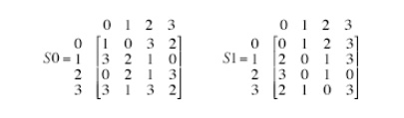

FINAL ENCRYPTION
STEP 4- SPLIT THE OUTPUT BITS INTO LEFT AND RIGHT BLOCKS AND PUT THE VALUE ON S-BOX(SUBSTITUTION BOX) S0 & S1.
STEP 5- TAKE THE 1ST AND LAST BITS OF BOTH THE HALVES AS ROWS AND 2ND AND 3RD BITS AS COLUMNS ON THE S0 & S1 BOX.
STEP 6- Combine the generated output bits and apply permutation 4(P4) On it.
STEP 7-TAKE THE LEFT HALF OF IP8 AND PERMUTED OUTPUT P4 AND XOR IT.
STEP 8- SWAP THE LEFT AND RIGHT HALF GENERATED AFTER STEP 7 AND COMBINE IT.
STEP 9- APPLY THE STEP 2 TO 8 WITH THIS PLAIN TEXT FOR SUBKEY 2 (K2).
STEP 10- THE LAST GENERATED PALIN TEXT WOULD BE CIPHER TEXT FOR S-DES.

